Slide 1
UART
(Universal Asynchronous Receiver-Transmitter)
Protocol

Slide 2
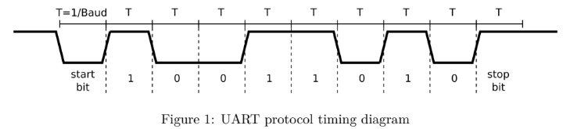
UART
Protocol:
Normally high (‘1’) when not in used.
Serialize a Data (0x59)
Initial Requirements:
Top-level module ports (clk, nrst, tx)
Baud rate of 9600bits/sec

Slide 3
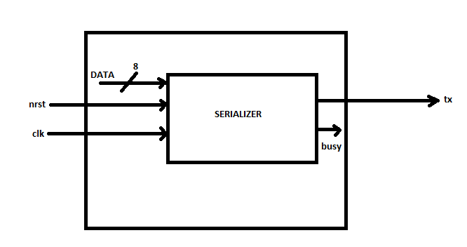
UART
Initial Design Block Diagram:

Slide 4
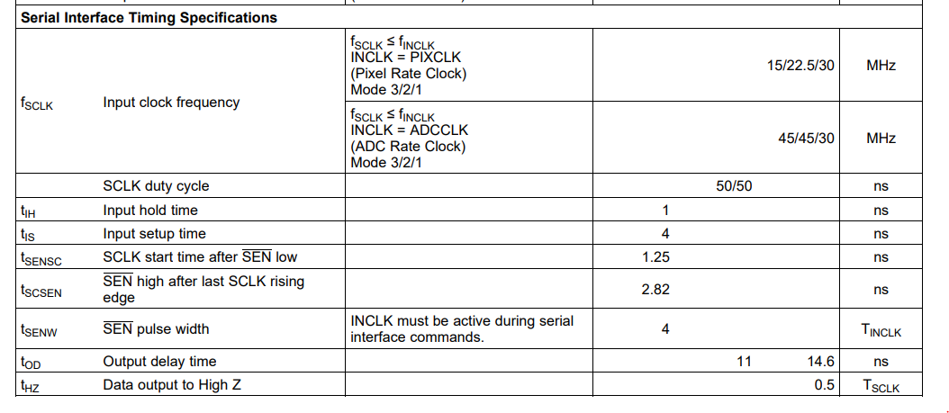
UART
Clock Specification:
(LM98714 Three Channel, 16-Bit, 45 MSPS Analog Front End With LVDS/CMOS Output and Integrated CCD/CIS Sensor Timing Generator)
Input clock frequency of 30Mhz.
https://www.ti.com/lit/ds/symlink/lm98714.pdf?ts=1623995244902&ref_url=https%253A%252F%252Fwww.ti.com%252Fproduct%252FLM98714

Slide 5
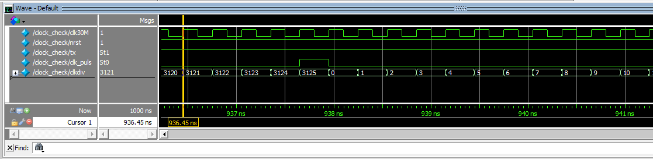
UART
Counter:
Baud = 9600
Clk_freq = 30 000 000 → 0.3ns (in one clock cycle)
(30M)/9600 = 3125 → counts per 1 bit
Log2(3125) = 11.6 ≈ 12 → bits
**Take note: baud rate must be varied so we need to, implement Log2 in the code. But for the initial trial we will pre-set this parameter.

Slide 6
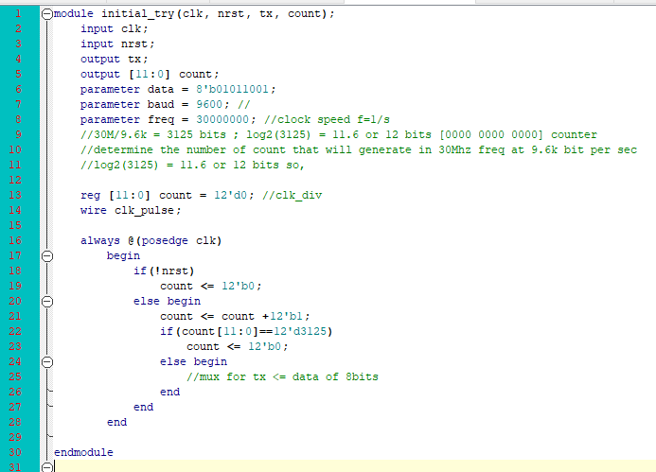
UART
Base module:

Slide 7
UART (Phase II)
(Universal Asynchronous Receiver-Transmitter)
Protocol

Slide 8
UART: PHASE II - changes
Clock Specification
Update the counter
Add a Bit count
4-Bit register that loops in every 0-9 count
Add a 2-bit State Transition
00 – busy/ idle
01 – start bit
10 – stop bit
11 – data is sending
Shifter (8-bit in to 1-bit tx)
Transmits Different Character
Loop condition for 100ms interval.

Slide 9
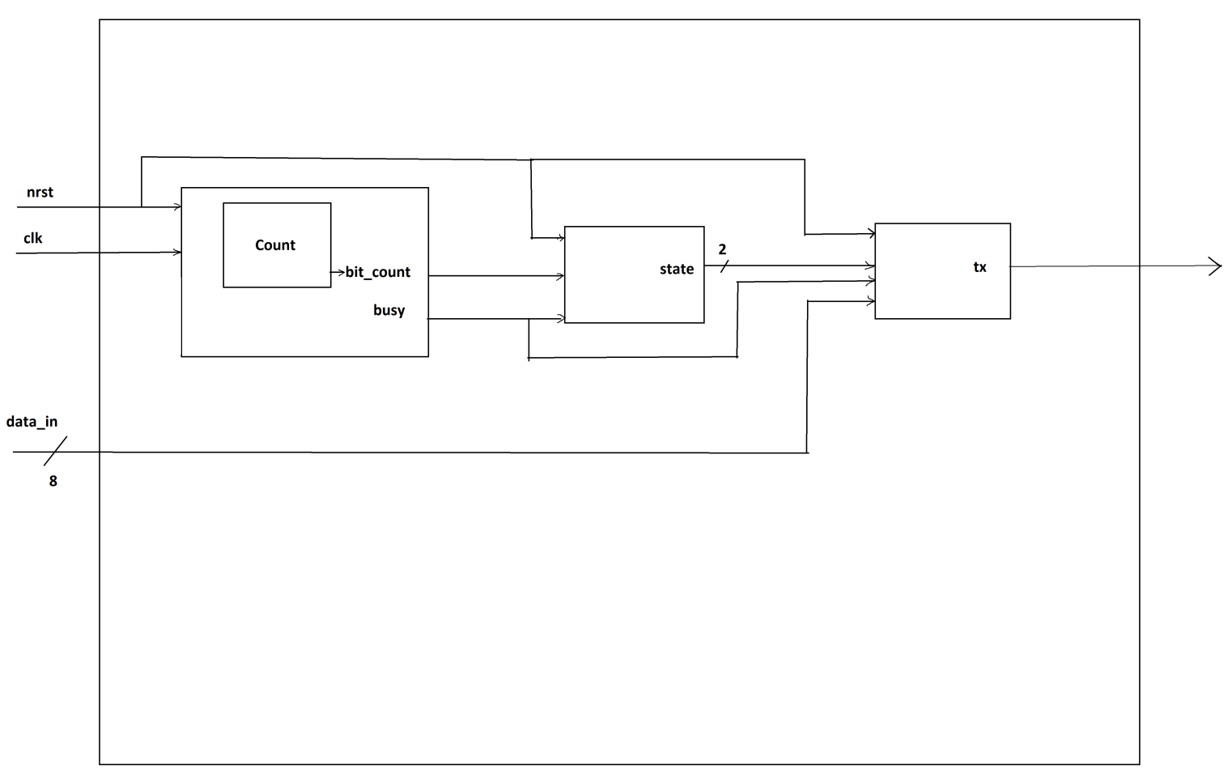
UART: Block Diagram
Block Diagram:

Slide 10
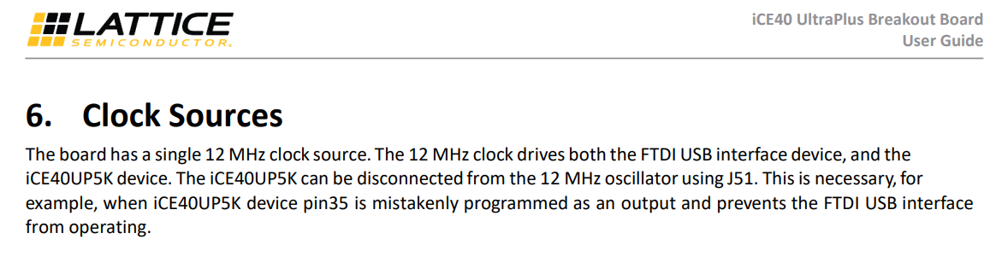
UART: Clock Specification:
Counter:
Baud = 9600
Clk_freq = 12 000 000 → 83.33ns per cycle or 41.66ns per half cycle
(12M)/9600 = 1250 → counts per 1 bit
Log2(1250-1) = 10.29 ≈ 11 → bits

Slide 11
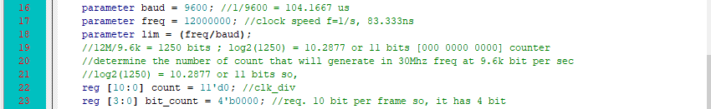
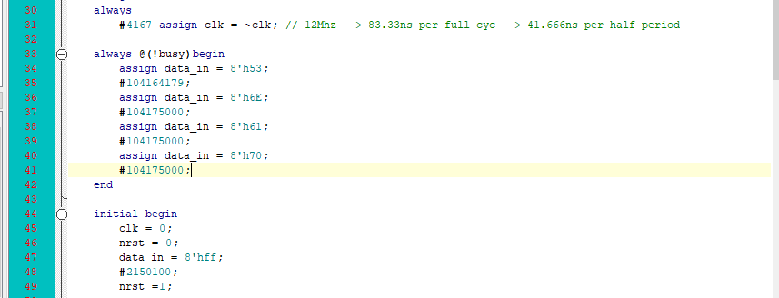
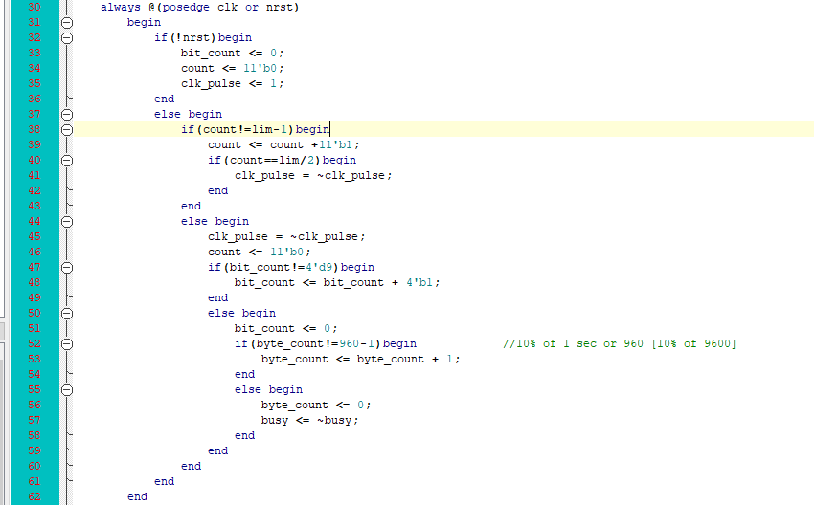
UART: Code Implementation
Clock Adjustments & Adding a Bit count:
Base module: test bench:

Slide 12
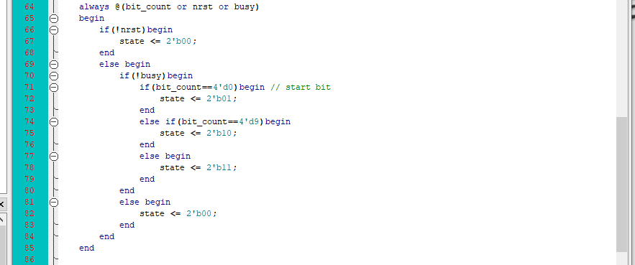
UART: Code Implementation
State Transition Block:

Slide 13
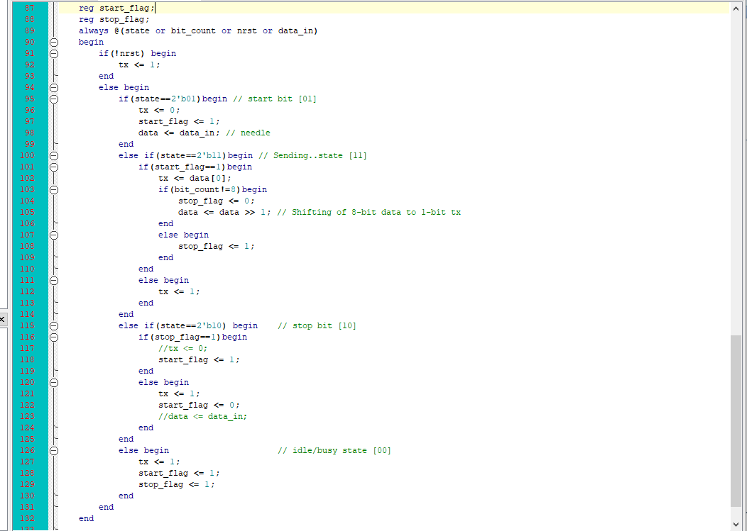
Code Implementation
Assigning the Output of Tx:

Slide 14
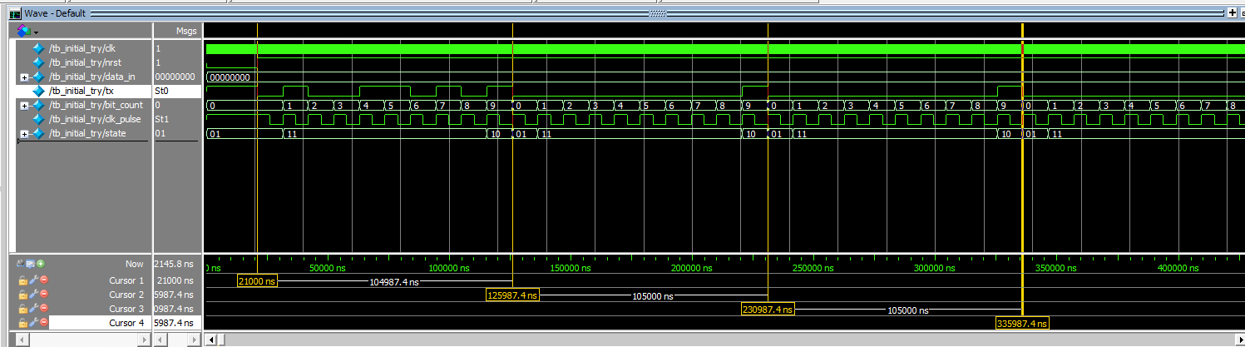
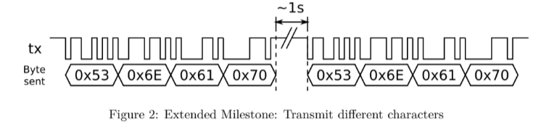
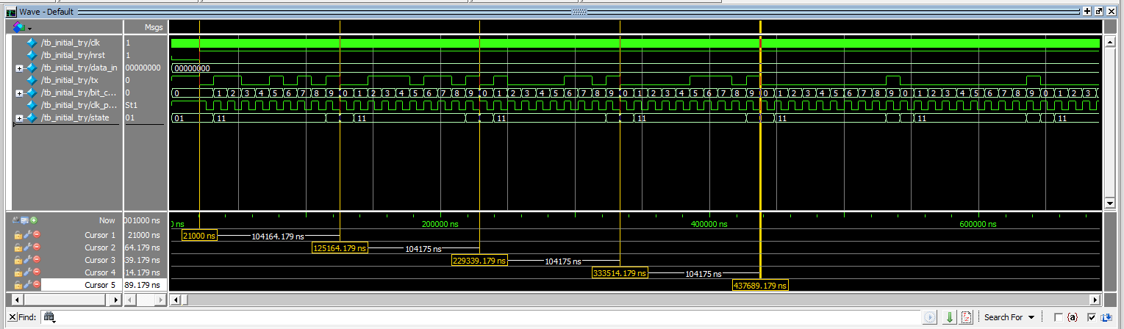
UART: Transmit Different Character

Slide 15
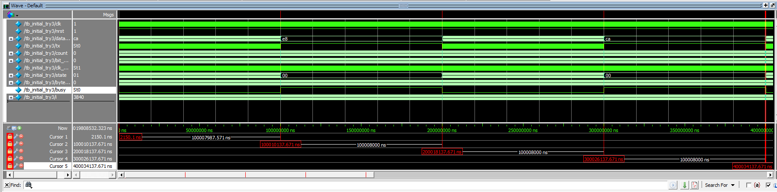
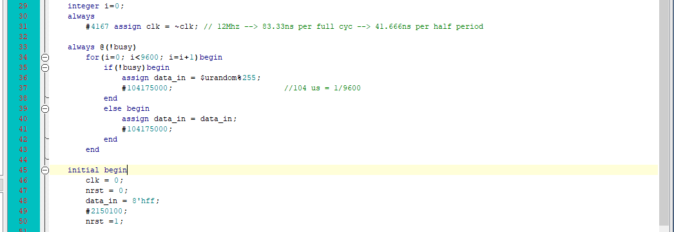
UART: Loop condition for 100ms interval
Test bench:

Slide 16
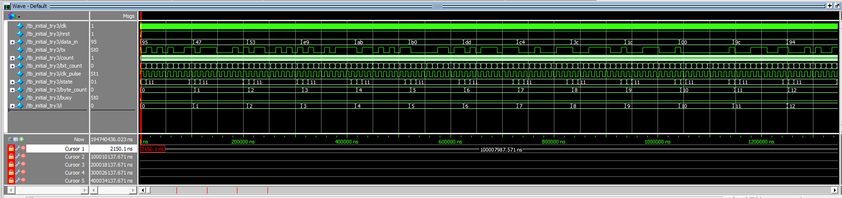
UART: Loop condition for 100ms interval

Slide 17
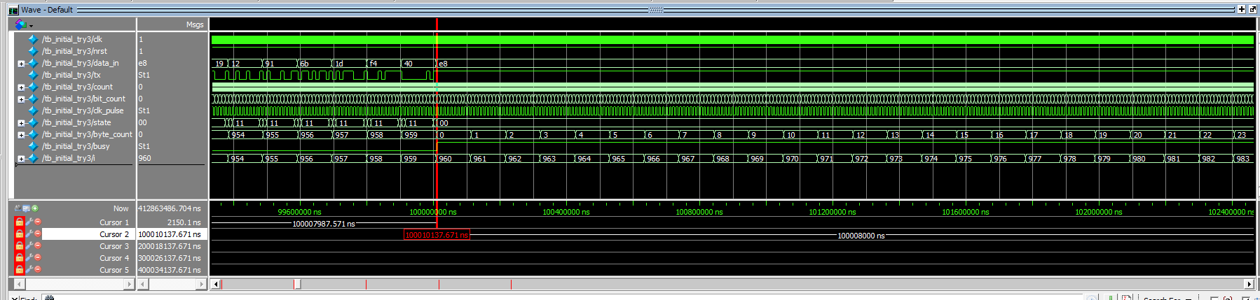
UART: Loop condition for 100ms interval

Slide 18
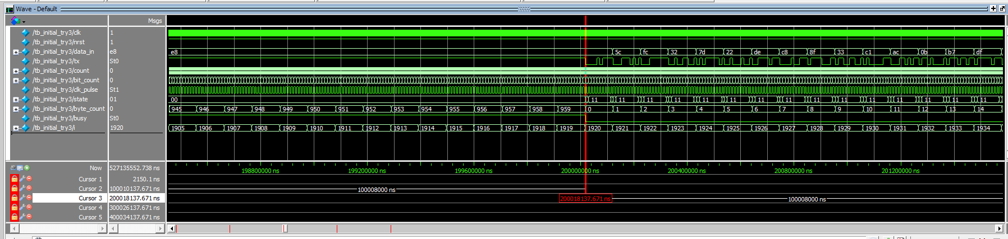
UART: Loop condition for 100ms interval

Slide 19

UART: Loop condition for 100ms interval

Slide 20
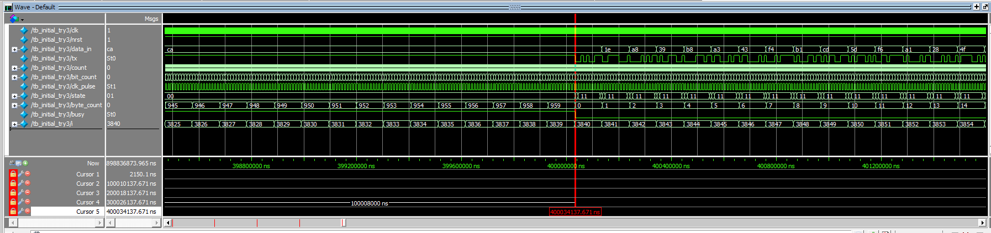
UART: Loop condition for 100ms interval

Slide 21
The End

